Slide 1
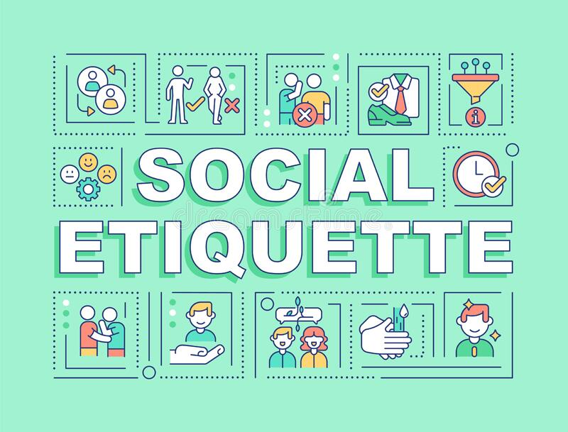
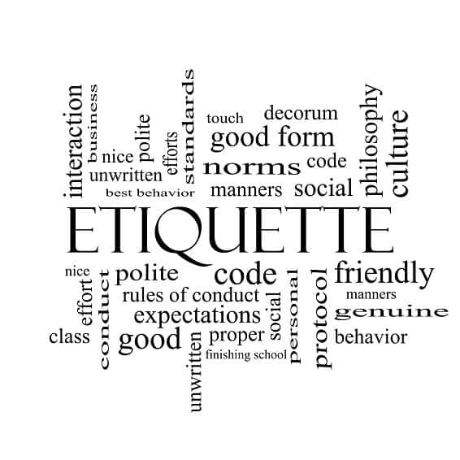
Social etiquette

Slide 2
What is Etiquette?
Etiquette is the set of conventional rules of personal behavior in polite society, usually in the form of an ethical code that delineates the expected and accepted social behaviors that accord with the conventions and norms observed by a society, a social class, or a social group.

Slide 3

.
Etiquette or good manners are decent social conduct that builds healthy relationships and takes you ahead in life. The idea behind why you should practice social etiquette is to appear formal to strangers or business partners and be a likable and trustworthy person in society. Learning social etiquette takes a little time and experience as the rules are not set in stone and evolve with times and trends. However, all social etiquette and manners have a common denominator that, when understood, makes it easier to learn. This article talks all about social etiquette in different settings that you may not have known.

Slide 4
What Is Social Etiquette?
Humans are social beings who need to follow specific rules of social interactions to facilitate interpersonal relationships. Social etiquette need to be followed in social situations to be respectful and courteous towards everyone present. This also extends to interactions with friends, family, and relatives. While social etiquette reduces conflict and promotes harmony, it also influences how others perceive you. You will leave behind a lasting impression on the other people, establishing a sense of trust and reliance, and in return, you are treated well and earn their trust.

Slide 5
Why Is Social Etiquette Important?
While social etiquette might seem like an endless list of unnecessary rules that are, it is good to follow such etiquette that will eventually benefit everyone. Here are some reasons why good social etiquette is needed:

Slide 6
1. It shows people how to behave
Social etiquette is not always apparent in all social settings, and sometimes people wouldn’t know how to behave in certain situations. When they arrive at the point where they have to question their behavior, etiquette learned previously acts as a good reference.
2. It helps you to look like a kind and approachable person
Etiquette makes you look like a kind person who cares about the well-being of others. Your warm behavior also makes you seem like an approachable person who encourages others to interact with you.

Slide 7
3. Makes interactions easy
Social etiquette eases interactions between people by removing misunderstanding and unnecessary drama. It can also lessen confrontation that might arise from misunderstandings.
4. It becomes easy to build and maintain connections
A well-behaved, courteous person is easy to talk to and establishes himself as trustworthy. Such people are better able to create new relationships and maintain old ones.

Slide 8
5. Improves communication
Communication is not only the spoken language but also the general behavior exhibited towards others. Good etiquette communicates more about the person you are than your words.
6. Makes a good impression
Good etiquette is essential at workplaces as it makes you look more professional and make a good impression with everyone.

Slide 9

Types of Social Etiquette
Social Etiquette
Face-to-face Etiquette
Meeting Etiquette
Eating Etiquette
Telephone Etiquette

Slide 10
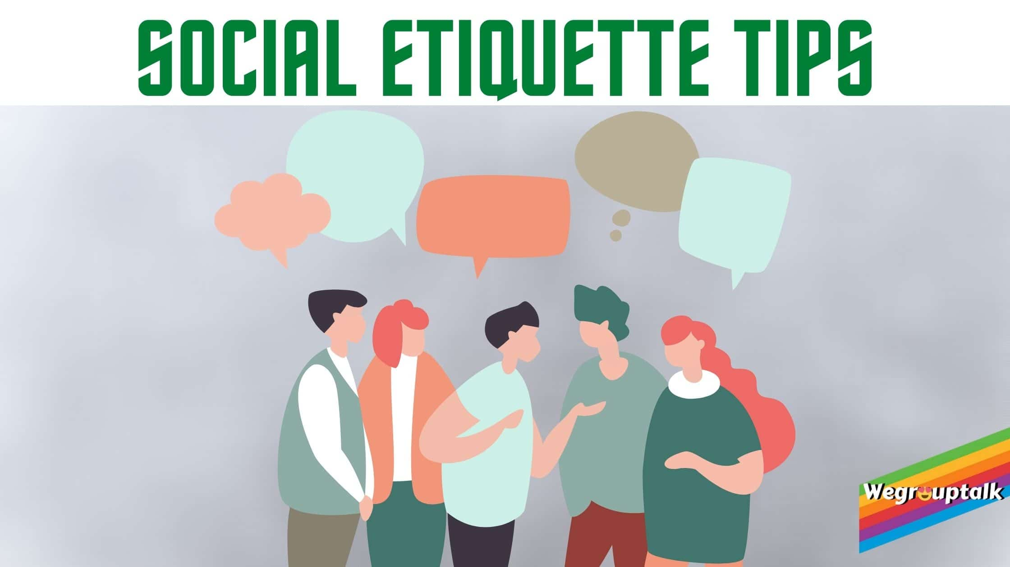
RULES OF ETIQUETTE
*Be yourself -and allow other to treat you with respect…
*Say “thank you”
*Give genuine compliments…..
*Don’t be Boastful, Arrogant or loud…..
*Listen before speaking….
*Speak with kindness and caution…
*Don’t criticize or complain….
*Be punctual…..

